Slide 1

Table Tennis Shots Detection Using Machine Learning
Course: I3308 Final Project
Done by: Ali Koteich
Under the supervision of:
Dr. Mohamad Chaitou

Slide 2
Contents:
Introduction
Literature Review​
Methodology​
Results​
Conclusions​
Discussions

Slide 3
Background
Introduction:
Artificial Intelligence is involved in every domain around us due to its efficiency in solving many problems.
In sports, AI is applied in football, basketball, tennis and plenty of other games where statistics and analytics is improved significantly.
Another good application of AI is in table tennis, which is a Machine Learning model that detects the type of shot performed and makes a statistics around the gameplay.

Slide 4
Project Aims and Objectives
To detect the type of shot a player is playing.
To make a statistics around the gameplay.

Slide 5
Table tennis main shots
Forehand topspin
Forehand slice
Backhand topspin
Backhand slice
Bad form shot

Slide 6
Literature Review
Table Tennis With Machine Learning: Table tennis model that detects the type of shot performed using a gyroscope and accelerometer sensors to record data and Tiny Motion Trainer framework to train the model.
Walk or Run: Detecting Motion Activity with Machine Learning and Core ML using Neural Network

Slide 7
Project Methodology
Data Collection: Tools and sensors used for collecting data
Data Preprocessing: Filtering the shots and setting a trigger and a threshold for recording shots
Feature Engineering: Manipulating and transforming raw data into a clean dataset
Implementation: Splitting and normalizing the dataset
Predictions: Applying Neural Network to predict the output of the shots

Slide 8
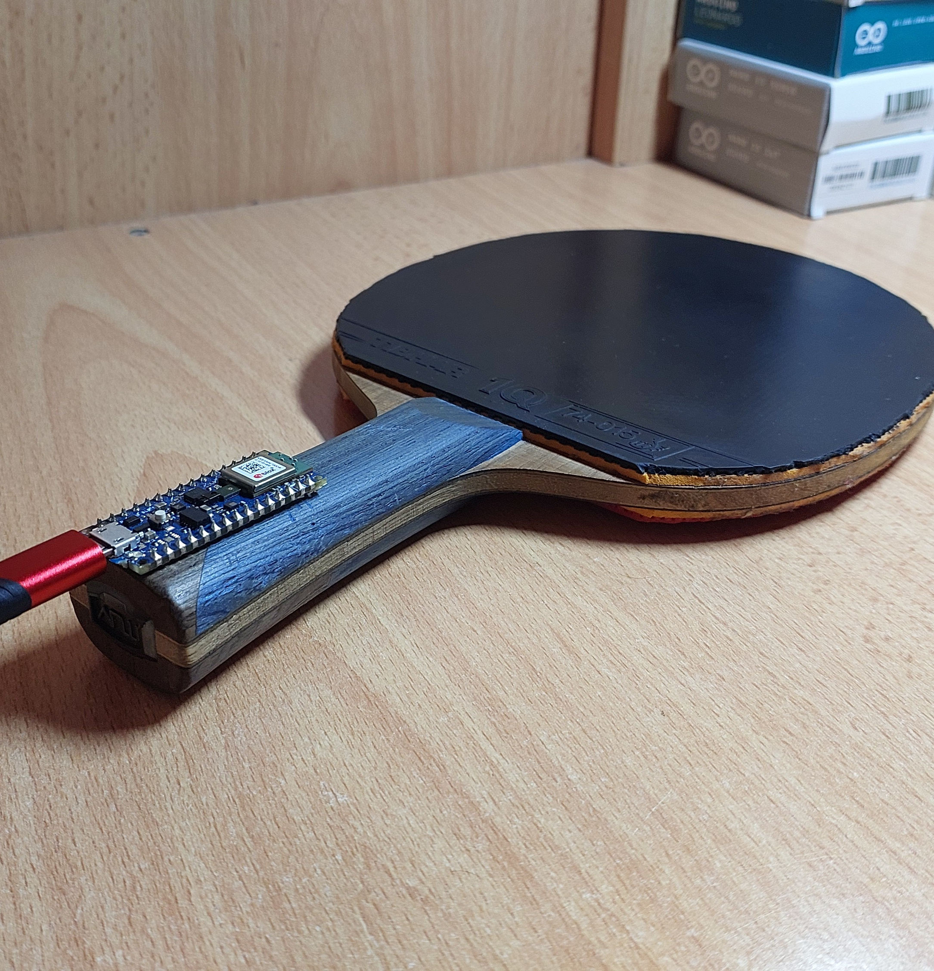
Data Collection
A gyroscope and an accelerometer sensors are used to record shots
The Arduino Nano 33 BLE Sense board supports both sensors
Using the Arduino IDE Platform, set up the board and sensors and start recording the data.

Slide 9
Data Preprocessing
Gyroscope and accelerometer sensors record the 3-axis coordinates (gX, gY, gZ, aX, aY, aZ).
The threshold is the average of all 6 coordinates.
The trigger is set to 0.30 as a convenient value.
Between each shot exist a delay of 600 ms.
A trigger and a threshold are set to record shots filtered from noise.
Each shot consists of 10 samples of each coordinate.

Slide 10
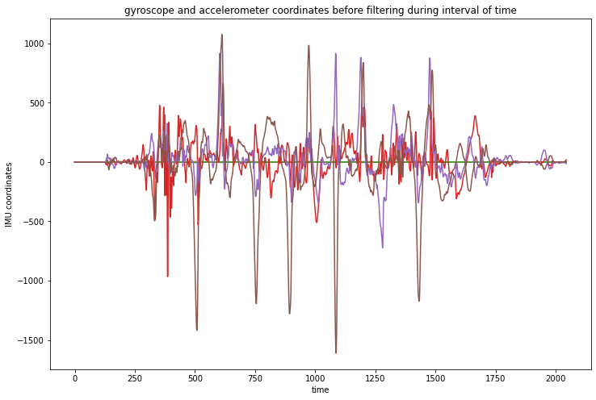
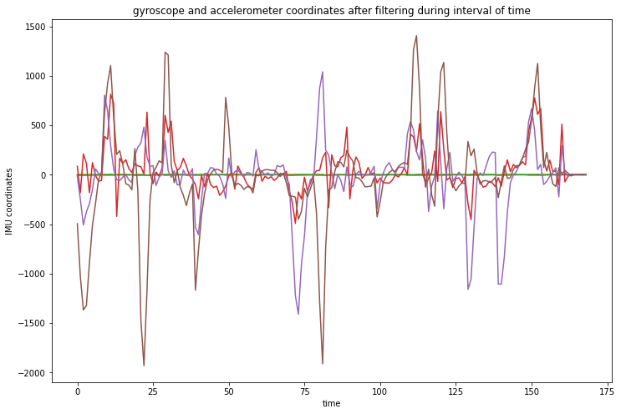
Data before and after filtering

Slide 11
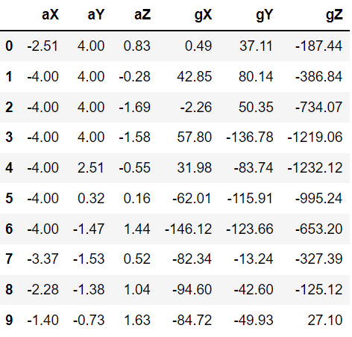
A single shot
10 gyroscope x-axis samples
10 gyroscope y-axis samples
10 gyroscope z-axis samples
10 accelerometer x-axis samples
10 accelerometer y-axis samples
10 accelerometer z-axis samples

Slide 12
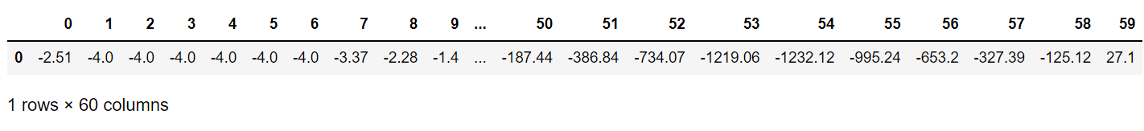
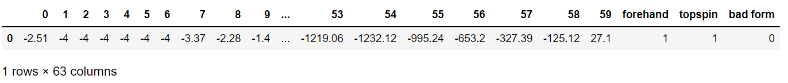
Feature Engineering
Converted the 10x6 matrix into a 1x60 matrix single row shot
Added the labels to the end of each dataframe

Slide 13
Dataset
1951 shots collected by experiment:
400 forehand topspin samples
400 backhand topspin samples
401 backhand slice samples
400 forehand slice samples
350 bad form samples

Slide 14
Implementation
Data normalization between 0 and 1
Splitting the dataset into train and test sets
70%
30%
Train Set
Test Set

Slide 15
Why Neural Network?
60 input features
3 output labels
Accuracy is a key factor

Slide 16
Evaluation Metrics
Training Accuracy
Training Loss

Slide 17
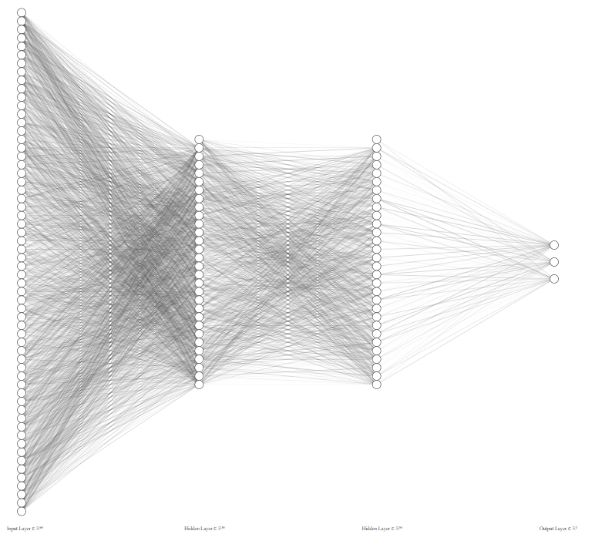
Neural Network Hyperparameters
input layer with 60 neuron
2 hidden layers with 30 neurons each
Output layer with 3 neurons

Slide 18
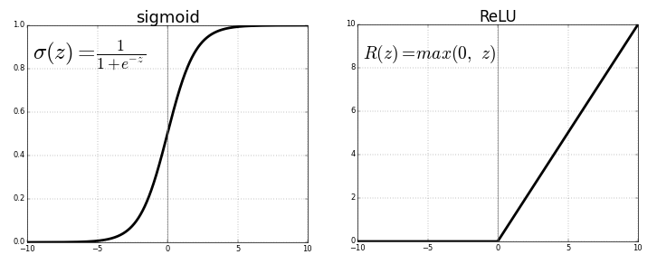
Activation Functions
ReLU Function for input and hidden layers
Sigmoid Function for output layer

Slide 19
Loss Function
Loss Function |  | Binary Cross Entropy | Categorical Cross Entropy | MSE | MAE
Metrics | training accuracy | 0.688 | 0.5670 | 0.988 | 0.993
 | training loss | 0.002 | 746598.9375 | 0.006 | 0.004
Regression Loss Functions gave significantly better results than classification Loss Functions

Slide 20
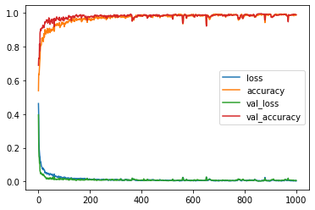
Training the Neural Network
Learning Rate: 0.01
Number of epochs: 1000
Batch size: 64

Slide 21
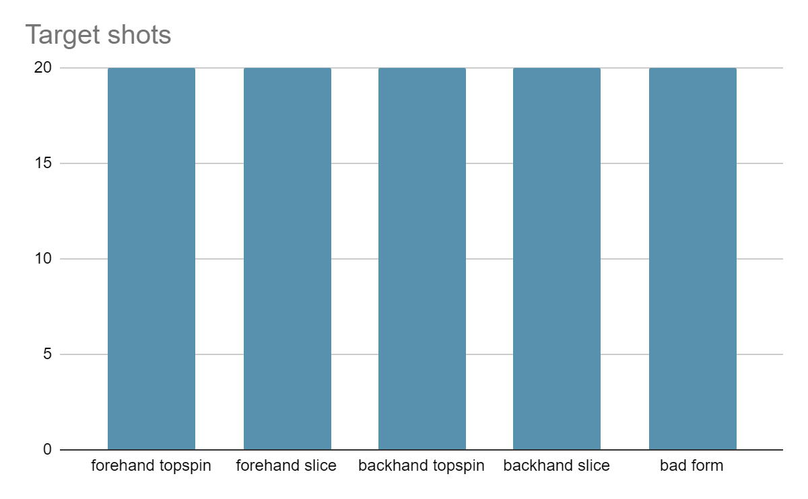
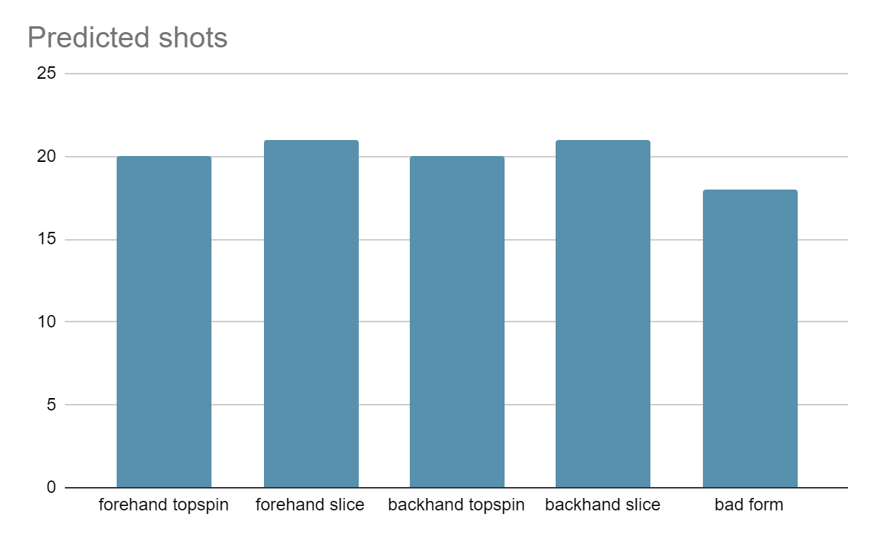
Final Predictions

Slide 22
Conclusions
Shots are correctly detected with accuracy of 98%.
Statistics of shots are represented as a bar graph

Slide 23
Discussions
Limitations: Only applies on left-handed players since I collected the data, and I am left-handed
Possible improvements: Collect the data from different players to include all variety of shots.
Future work: Creating a model that detects the quality of shots and the level of the player.

Slide 24

Thank you
I welcome any question

